Slide 1
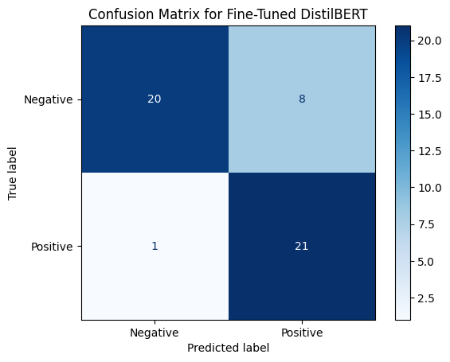
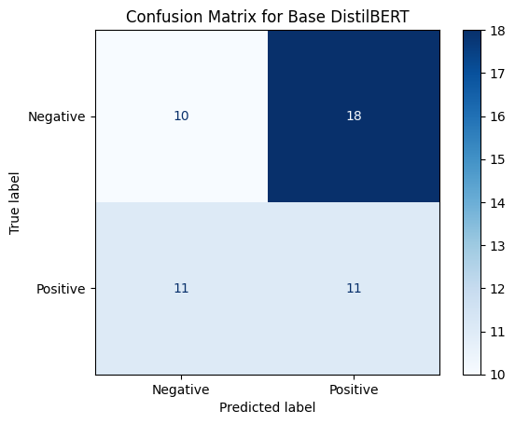
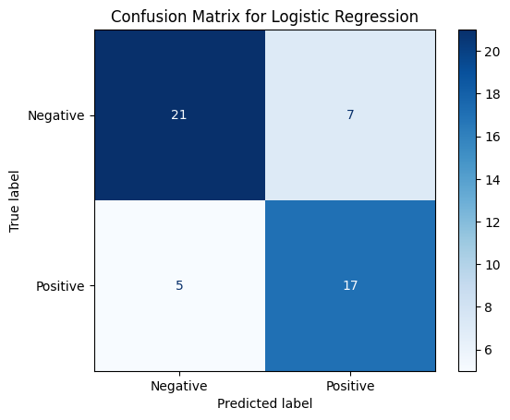
Project 2 Presentation Name: Eli Bryson
Answer the questions:
1. What do the accuracy and loss curves tell you about the fine-tuning process? They show the performance and behavior of the model during the fine-tuning process.
2. How does the fine-tuned DistilBERT model compare to the classical ML model? The fine-tuned DistilBERT often delivers better performance than the classical ML model.
What advantages or limitations do transformers present over classical algorithms? The advantages of transformers is that they are specifically designed to handle sequential and context-dependent data.
3. What insights can you draw from the confusion matrix? Are there any patterns in the misclassifications?
Fine-Tuned: More false positives Base: High false positives & negatives Logistic Regression: Confuses positives with negatives
4. Why might the fine-tuned model outperform the base model? A fine-tuned model is trained on a task-specific dataset whereas the base model is trained on a large, general-purpose set to learn language patterns.
5. Which model would you recommend for deployment in a real-world scenario, and why? Consider both performance and efficiency in your answer. The fine-tuned model since it would result in the best performance when deployed long term.
I did everything except the optional GPT-2 model comparison.
Comparative Table:
Model (Avg) | Accuracy (Avg) | Precision (Avg) | Recall (Avg) | F1-score (Avg)
Fine-tuned | 0.82 | 0.7241 | 0.9545 | 0.8235
Base | 0.42 | 0.3793 | 0.5 | 0.4314
Logistic Regression | 0.76 | 0.7083 | 0.7727 | 0.7391

